Slide 1
Oracle Financials
Account Payables
Toshiba Information Equipment Phils.,Inc.
2023.07.24
Scope of Disclosure | within TIP only
Head of Information Owner Section | TIP

Slide 2
Account Payables
What is AP?
TIP SUBSYTEM FOR AP
AP PROCESS FLOW
COMMON SETUP IN AP

Slide 3
Account Payables (AP)
Is an accounting entry that represents the company’s obligation to pay off a short/long-term debt to its suppliers.

Slide 4
AP TIP SUBSYSTEM
HRMS LASTPAY – the most recent salary payment made to an employee, which may include their basic salary, allowances, bonuses, and deductions up to the current date.
SSS/PRS WEB APPLICATION - Liquidation of request such as reimbursements, cash advance, travels.
Reimbursement of Consumable & Corp Token)
Meal Allowance in Training, Workshop, OB etc.
IMPEX – In short import and export. Freight Charges expenses
CANTEEN BILLING – It involves managing the canteen expenses from the employees using their allowances.

Slide 5
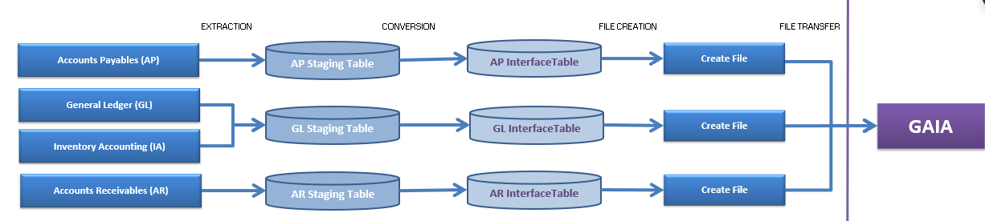
The stages of GAIA Interfacing
Extraction
Conversion
Data file creation
Data file transfer

Slide 6
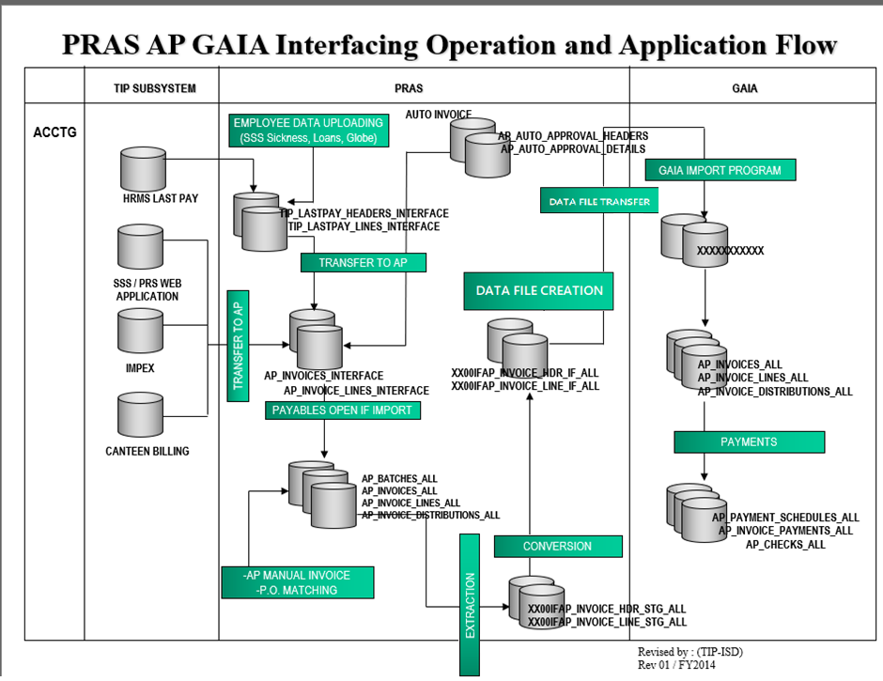

Slide 7
PROGRAM
xx00ifap_interface_conc_sv_tip.main_extr (EXTRACTION)
xx00ifap_interface_conc_sv.main_conv (CONVERSION)
xx00ifcmn_func_util_sv.flatfile_creation (DATA FILE CREATION)
XX00IFCMN_FTP (DATA FILE TRANSFER)

Slide 8
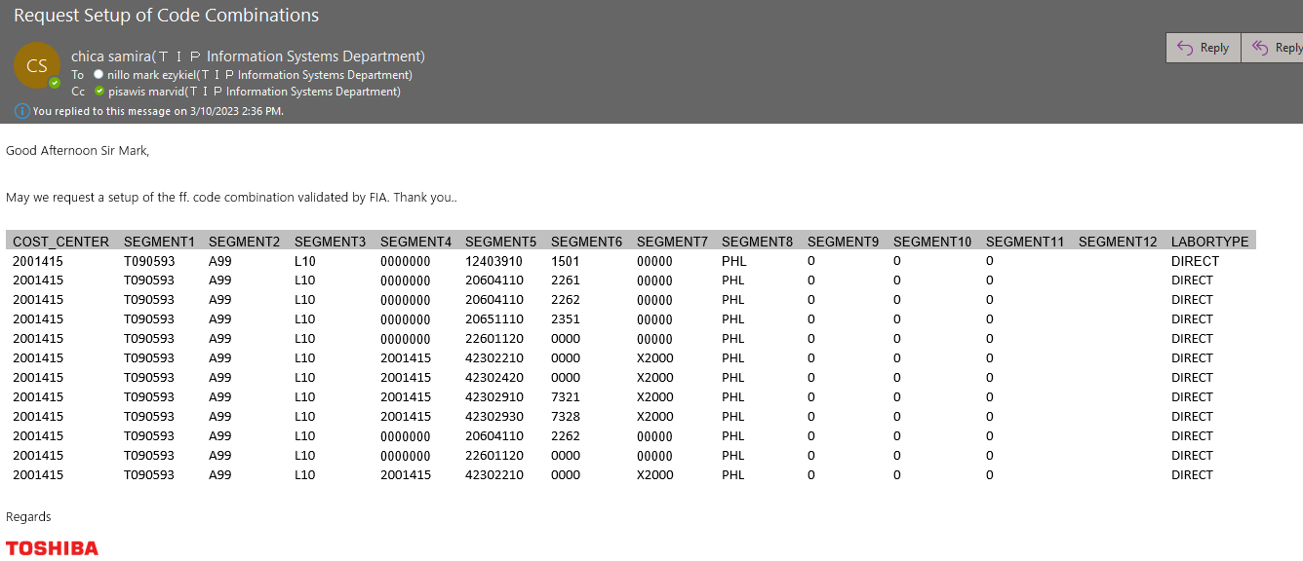
LASTPAY SETUP

Slide 9
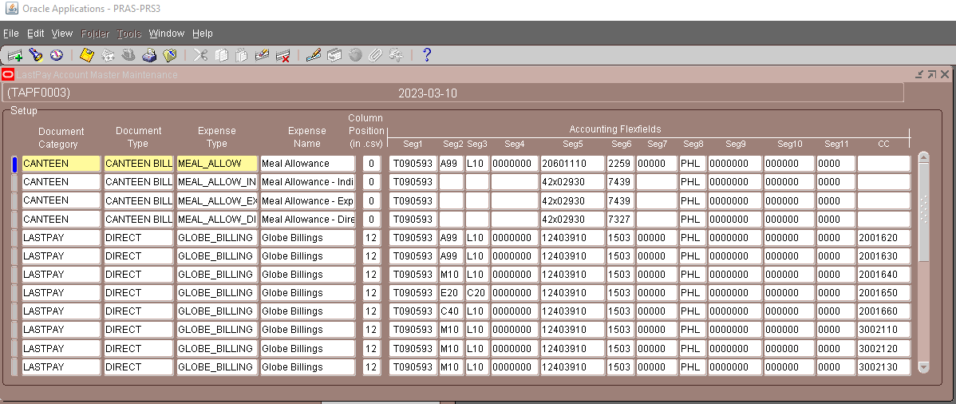
LASTPAY SETUP
TIP AP ADD-ON SYSTEM > TIP LASTPAY SYSTEM & OTHER > SETUP-ACCOUNTING CHARGING

Slide 10
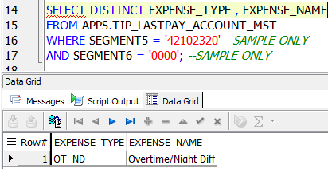
LASTPAY SETUP
SELECT DISTINCT EXPENSE_TYPE , EXPENSE_NAME
FROM APPS.TIP_LASTPAY_ACCOUNT_MST
WHERE SEGMENT5 = '42102320' --segment5
AND SEGMENT6 = '0000'; --segment6

Slide 11
END

